Slide 1
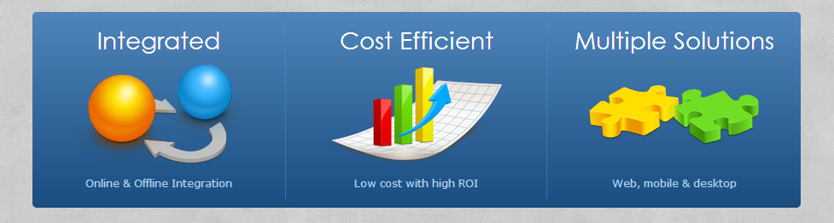


RRA Soft – PropertyMap.info
RRA Software Management LLP
http://RRASoft.com

Slide 2
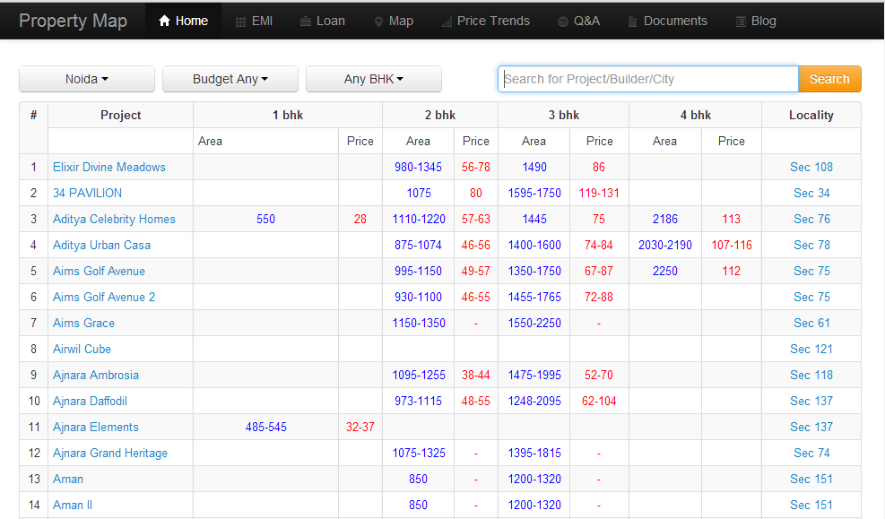
PropertyMap.info

Slide 3
City
Price Trend
Project
Availability
Agent Client
Apartment Type
Agent
Builder/Agent/Customers
Apartment
Price List
Landmarks

